Slide 1
OUTPUT REPORT
Implementation of Robotic Process Atomization in Hospitals
By - Siddhant Bane

Slide 2
Database Cleaning
The ADMISSIONS.csv database has been cleaned and the useful records are stored in the files: admissions_predict_LOS2.csv and admissions_target_LOS.csv in clean-db directory.
The columns: ADMITTIME, DISCHTIME, EDREGTIME and EDOUTTIME are all cleaned up and put into columns of numeric data type for year, month, days, hours and minutes.

Slide 3
Database Cleaning
Columns with categorical outputs (eg: insurance, admission_type) are made into their own tuples with binary data to encode them in normal distribution. This is helpful when doing any prediction using the said data. The file admin-features-clean.py has a modular code for doing this with any database with slight modifications to the attribute name entries.
In the PRESCRIPTIONS.csv database the DRUG column is used to carry out calculations on the number of times a particular drug is used in the time frame of this data collection. Exact time interval is unknown as the “Dates” in the data are masked.

Slide 4
Database Cleaning
The columns DOSE_VAL_RX and FORM_VAL_DISP have the values of the dosage of the drug given with respect to the patient. But the the values in these columns are of different units and sometimes they aren’t even exact values.
Such features can’t be used in any prediction method.

Slide 5
Observations
The frequency of each drug used by the hospital is calculated and the record is stored in file: Drug-sorted-dece.csv in the descending order of their use.
A total 210 drugs have the max usage of 192,993 instances.
The total drugs used by the hospital used in this database is: 4525. With the least drug being Micardis HCT used only 2 times.

Slide 6
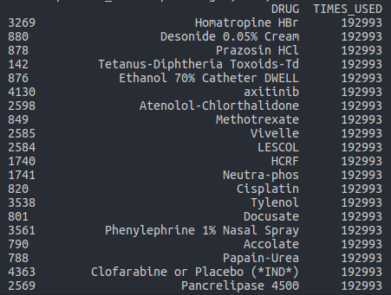
Most used drugs:

Slide 7
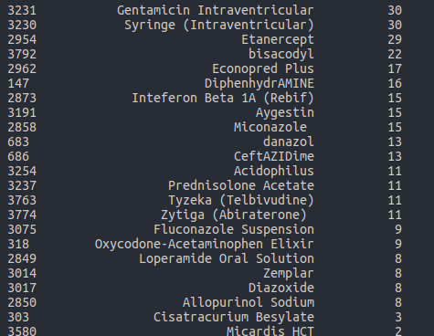
Least used drugs:

Slide 8
Observations
The most number of patients are admitted in August. 5181 patients across all years.
The total number of years cannot be known from the data because of masked years in the data.
The least number of patients are admitted in Feb and Nov, with 4568 and 4712 patients respectively across all years.
The pivot tables for recording more such observations can be generated using the cleaned up databases easily.
The python file: get-meta.py can also be modified according to the need to generate these pivot tables directly in the pandas framework

Slide 9
Observations
The mode of length of stay (LOS) in the hospital is 4 days. It is highly unlikely for the stay to be longer than a 30 days. As there are only a handful of outliers.
Over 80% of cases last less than 20 days.
Cases lasting more than 30 days can be considered outliers.
The average LOS in the hospital is recorded to be close to 10 days. With standard deviation being 12.5 days and variance being 156.

Slide 10
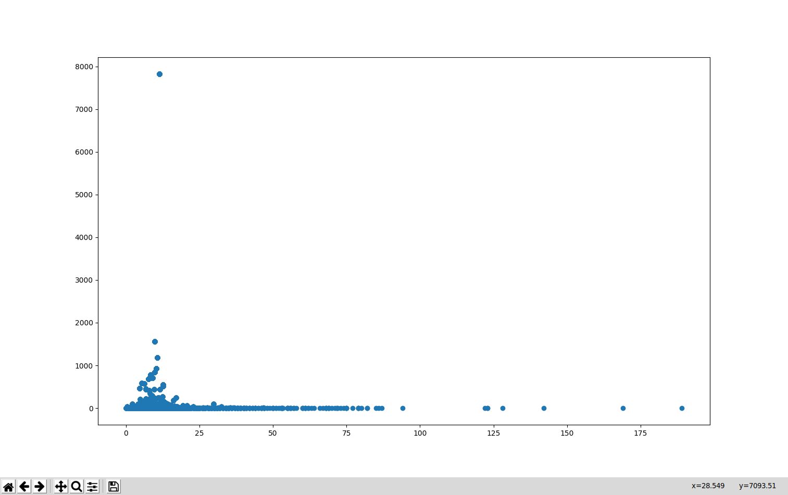
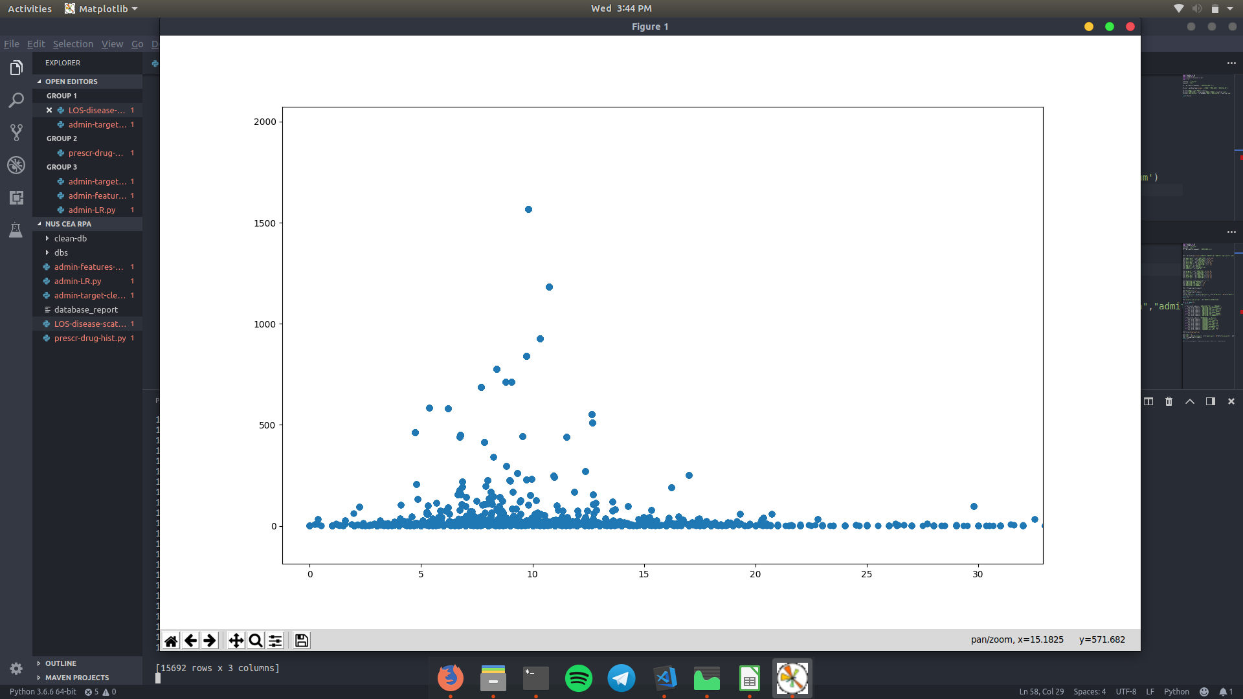
LOS v Number of patients wrt Diagnosis
Fig 1
Fig 2
Info about the plot in next slide.

Slide 11
Fig 1-2:
Each plotted point represents a distinct diagnosis
The x-axis is for average LOS in days. The y-axis is for Number patients given that particular diagnosis.
Fig 2:
It is clearly seen that the bulk of the cases have average LOS lower than 30 days.
The distribution between these cases can also be seen more clearly from this plot

Slide 12
admin-LR.py
This file contains code for prediction of LOS using cleaned data.
It uses Lasso regression and uses database with normalised features.
Lasso regression is selected as it is more likely to drive the coeffs of the features to 0, so as to eliminate the non contributing features.
The code outputs a 1 dimensional array of coeffs of the feature set taken in as input at lambda = 0.3 for a relatively smaller feature set.

Slide 13

admin-LR.py
Lagrangian form of Lasso regression
Lambda is a free parameter set by us beforehand that determines the regularisation.
The default value for lambda is 0.1. It needed to be increased in steps of 0.1 until we got non-zero coefficients.
The value of lambda is heavily data dependent. So for prediction of LOS with more attributes re-evaluation of lambda is required. Adding more attributes will most likely decrease the value of lambda needed to be applied. Hence less regularisation will be needed.

Slide 14
Observations
The most number of cases for admission in the hospital were for NEWBORN at 7823 cases followed by PNEUMONIA and SEPSIS and CONGESTIVE HEART FAILURE at 1566, 1184 and 928 cases respectively over the recorded years.
The pivot table for this can be drawn using the LOS-diseases-scatter.py file. It also outputs a scatter plot of freq v LOS for the data given.

Slide 15
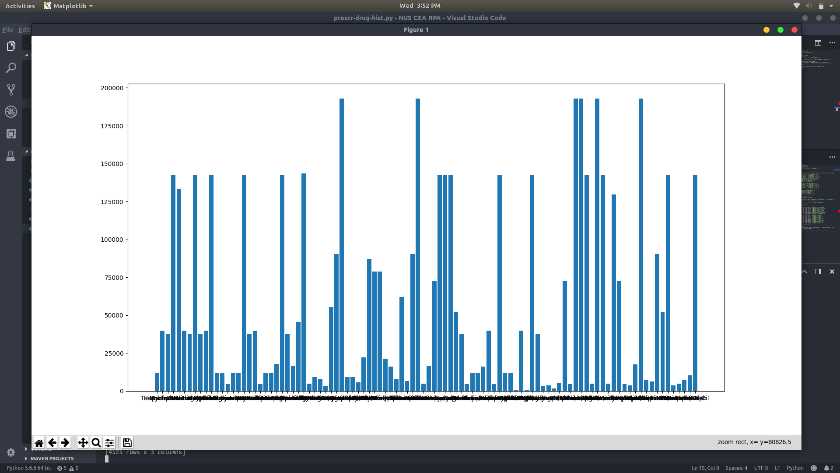
Observations
For observing the Diagnosis wise LOS histogram use the prescr-drug-hist.py file.
The file outputs the histogram for the same and can also be used to pivot table creation for other datasets as well using small modifications.

